Slide 1
Module 3: SSIS Development

Slide 3
Agenda
Project vs Package
Connection Manager
Variables vs Parameters
Expressions
Connection Strings
Control Flow
Precedence Constraints
Data Flow
Event Handlers
Control Flow Parts

Slide 4
Project vs Package
Projects Contains
One or more packages
Project Parameters
Connection managers (shared connections)
Control flow parts
Package Contains
Control Flow
Data Flow
Package Parameters
Event Handlers
Connection manager (dedicated).

Slide 5
Projects vs Packages
Demo
Notes:
Demo: Module 03: Projects vs Packages

Slide 6
Projects vs Packages
Lab 1

Slide 7
Connection Manager
Allows SSIS to connect to any number of sources for both input and output.
There are built in drivers such as OleDB, Flat File, ADO.NET, Analysis Service, etc.
Additional connections drives such as Odata, Hadoop, and Azure has been added in SQL Server 2016+.
Connections defined in connection manger are used for Control Flow, Data Flow, and Log Providers.

Slide 8
Connection Manager (2)
Following connection managers are only available in Control Flow.
FTP, HTTP, MSMQ, SMOServer, SMTP, and WMI

Slide 9
Connection Manager (3)
Following connection managers are available to both Source and Destination data flows:
Database (ADO.NET, OLE DB, or CDC Source) or File (Excel, Flat File, XML, Raw File).
Following connection managers are available only to Destination data flows:
SSAS (Data mining model training, Dimension processing, or partition processing) or Rowset (Data reader, Recordset).

Slide 10
Connection Manager
Demo
Notes:
Demo: Module 03: Connection Manager

Slide 11
Variables vs Parameters
Variables
Are package level only.
Are read-write.
Parameters
Are package or project level.
Cannot be modified directly but can be updated as a pass-through value.
Are type of variable.

Slide 12
Variables vs Parameters – Supported Data Types
Variables
Types available:
All the types of parameters.
Plus Char, DBNULL, Objects.
Parameters
Types available:
Boolean, Byte, DateTime, Decimal, Double, Int16, Int32, Int64, Sbyte, Single, String, UInt32, and UInt64.

Slide 13
Variables vs Parameters – Scope
Variables
Defined at development, can be granular as task level.
Can change the variable in design time only.
Scope: Package Level, Container Level, Data Flow, and Task Level.
Visible as User::VariableName
Parameters
Project Level – Visible to all Packages.
Visible as $Project::ParameterName
Package Level – Visible to package defined in.
Visible as $Package::ParameterName

Slide 14
Variables vs Parameters – System
Variables
System variable available for Projects, Packages, Tasks, etc. and are read-only.
Visible as System::VariableName
All system variables are not visible in all scopes (e.g. System::ErrorCode and System::ErrorDescription are only visible in OnError event handler).
Parameters
No system parameters.

Slide 15
Variables vs Parameters – Additional Information
Variables
Some variables need to be saved in the database to allow for persistence (e.g., CDC Control Task).
Parameters
Order of precedence for value assignment is Execution > Server > Design.
Has additional properties on sensitive and required.

Slide 16
Parameters
Lab 2

Slide 17
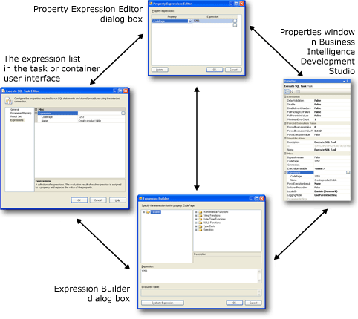
Expressions
Used to dynamic assignment or comparison, instead of hard-coding values.
Expression syntax is like C# Style
Value Assignment uses single equal (=)
Equality Comparison uses double equal (==)
Precedence Constraint, Conditional Split Transform
Data Type Casting : (data_type_to_cast_to) value
Variable referenced as @[NameSpace::VariableName] eg: @[User::MyCounter]
Notes:
https://docs.microsoft.com/en-us/sql/integration-services/expressions/use-property-expressions-in-packages?view=sql-server-2017

Slide 18
Expressions – Additional Info
Expression Builder GUI – Lists functions & function input parameters
New SQL 2012+ expression functions – LEFT, REPLACENULL, TOKEN, TOKENCOUNT
Removal of 4000-character limit for expressions, in SQL 2012+.

Slide 19
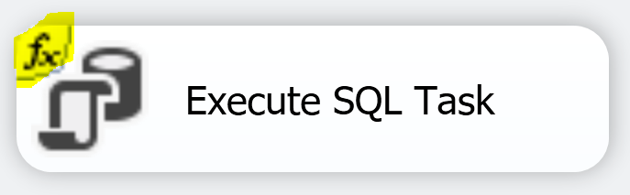
Property Expressions
Dynamically update task property at run time.
Any task or object that has expressions has “fx” added to the object to signal it is using expressions.
Can be set for:
Package, Task, Foreach Loop, For Loop, Sequence, Foreach enumerator, Event Handler, A package or project level connection manager, or Log Provider.

Slide 20
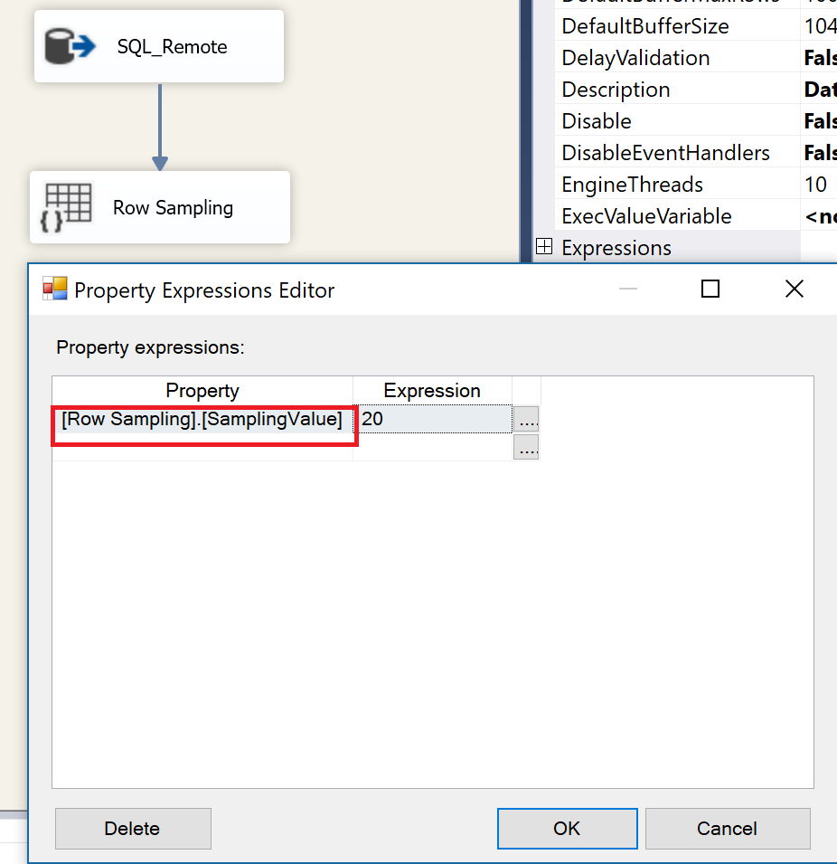
Property Expressions – Data Flow
Data Flow expressions are not straight forward. To set the expression, you must set the expression at Data Flow Task in Control Flow.
Expressions are not available for all data flow tasks.
Notes:
You will not be able set the expression by selecting the Source, Transform or the Destination.
You need to click on the canvas area or select the Data Flow Task from the Control tab in Visual Studio and then set the expressions that way.
https://msdn.microsoft.com/en-us/library/ms136104.aspx

Slide 21
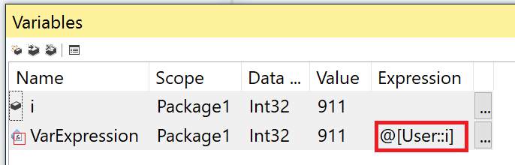
Variable Expressions
Assigns value to variable.
Dynamically update variable value property at run time.
Expression markers.

Slide 22
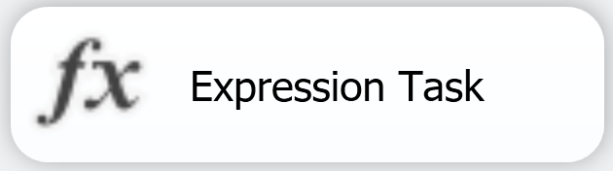
Expression Task
Assigns value to only one variable.
Introduced in SQL Server 2012+.
Not available in Data Flow Task.

Slide 23
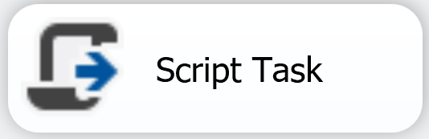
Control Flow Script Task
Can also be used to assigns value to variable(s).
.NET script can be used to assign values
Example: Dts.Variables["User::MyIntVar"].Value =911

Slide 24
Expression Task vs Script Task Variable Assignment
Expression Task
Only one value assignment
Quicker to modify
Script Task
Multiple value assignment possible.
A bit longer to modify, VSTA (VSTA need to be loaded each time to modify).

Slide 25
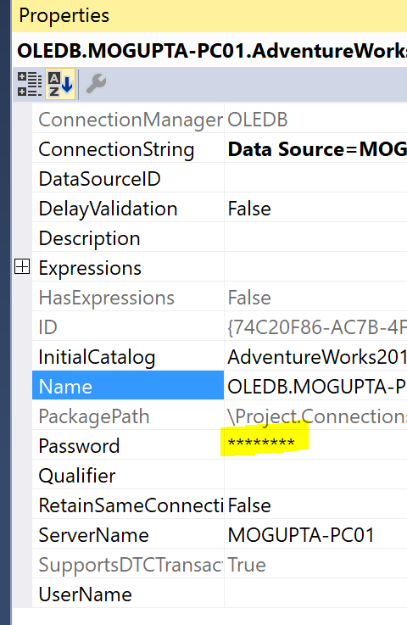
Sensitive Data
Sensitive SSIS properties
Password for connection string
Not all properties are sensitive, for example, we might want to protection Username also.
Workaround is promote the parameter for username to sensitive.
Notes:
Reference: https://docs.microsoft.com/en-ca/sql/integration-services/security/access-control-for-sensitive-data-in-packages

Slide 26
Variables & Expressions
Demo
Notes:
Demo: Module 03: Variables, Expressions & Parameters

Slide 27
Connection Strings
Defines how to connect to data source.
Provides all the important information, for example, for connecting to SQL Server:
Server Name
Instance Name
Port
Authentication Type (Trusted vs User Name / Password)
Database Name
Notes:
Handy tool for getting connection strings: http://www.connectionstrings.com

Slide 28
Connection Strings - Security
Deploy packages to SSISDB Catalog
Catalog automatically encrypts/decrypts based on Sensitive property.
Username is not sensitive
Workaround promote to property to parameter and set parameter as sensitive.
Password is sensitive

Slide 29
Connecting String – Security (2)
Package Protection Level
How to store sensitive values in file content
Set Project and all Package ProtectionLevel to be same.
Package Protection Level | Notes
DontSaveSensitive | Sensitive data is not saved in package. Must supply on execution via parameters.
EncryptSensitiveWithPassword | Password used to encrypt entire package content. To run or open in SSDT, must supply password.
EncryptSensitiveWithUserKey (default) | Uses current user profile to encrypt only sensitive values. Only same users can open package in SSDT. If different user opens in SSDT, must re-supply sensitive values.
EncryptAllWithPassword | Encrypt all values, not just sensitive with password.
EncryptAllWithUserKey | Encrypt all values, not just sensitive with current user profile.
Notes:
Reference: https://docs.microsoft.com/en-ca/sql/integration-services/security/access-control-for-sensitive-data-in-packages

Slide 30
Connecting String – Security (3)
Package Protection Level | Notes
ServerStorage (does not show in dropdown) | Used by SSISDB catalog, SQL 2012+ Catalog automatically encrypts the package data and sensitive values. Projects Exported from catalog automatically set to EncryptSensitiveWithUserKey With each project deployment creates Certifcate - MS_Cert_Proj_<Project_ID> Symmetric Key - MS_Enckey_Proj_<Project_ID> which is used to encrypt the project. First project execution creates Certifcate - MS_Cert_Proj_Param_<Project_ID> Symmetric Key - MS_Enckey_Proj_Param_<Project_ID> which is used to encrypt the project parameter values.
Notes:
Reference: https://docs.microsoft.com/en-ca/sql/integration-services/security/access-control-for-sensitive-data-in-packages

Slide 31
Connection String
Lab 3

Slide 32
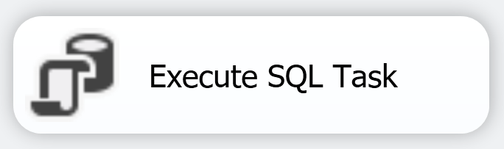
Execute SQL Task
Used to execute SQL statement(s) on various connect managers EXCEL,OLE DB,ODBC,ADO,ADO.NET,SQLMOBILE.
E.g.: truncate table before calling data flow task
retrieve email list to send personalized notification.
Required Properties
Connection Manager to use
SQL Statement to execute
Can accept Input & Output parameters
Parameter Marker and Parameter Name differs by Connection Manager Type.
Can assign result sets to variable
Notes:
https://docs.microsoft.com/en-us/sql/integration-services/control-flow/execute-sql-task

Slide 33
Execute SQL Task (2)
Passing parameter values depend on the driver type.
To capture an output in a result, add keyword OUTPUT in the SQL code.
Connection Type | Marker | Example
ADO | ? | SELECT * FROM T1 WHERE ID = ?
ADO.NET | @P1 | SELECT * FROM T1 WHERE ID = @P1
SQLMOBILE | @P1 | SELECT * FROM T1 WHERE ID = @P1
OLEDB | ? | SELECT * FROM T1 WHERE ID = ?
ODBC | ? | SELECT * FROM T1 WHERE ID = ?
EXCEL | ? | SELECT * FROM T1 WHERE ID = ?

Slide 34
Using Parameters to Call Stored Procedure
Lab 4

Slide 35
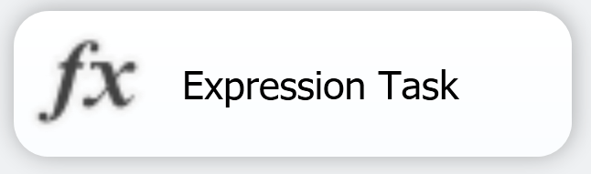
Expression Task
Builds and evaluates SSIS expressions that set variable values at runtime.
Introduced in SQL Server 2012
Required Properties
An Expression to assign value to the variable
You can not assign values to more than one variable.
Notes:
https://docs.microsoft.com/en-us/sql/integration-services/control-flow/expression-task

Slide 36
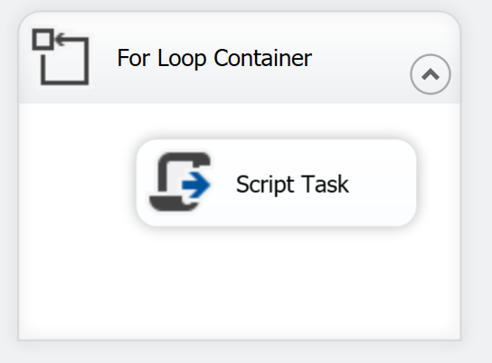
For Loop Container
Loop and execute tasks within container until expression evaluates too false.
Required Properties
Must use variable
InitialExpression
EvalExpression
AssignExpression
Eg:
Property | Sample Setting to execute Tasks within container 4 times
InitialExpression | @[User::Counter]=1
EvalExpression | @[User::Counter]<=4
AssignExpression | @[User::Counter]=@[User::Counter]+1
Notes:
https://docs.microsoft.com/en-us/sql/integration-services/control-flow/for-loop-container?view=sql-server-2017

Slide 37
For Each Loop Container (2)
To Implement While Loop
Declare variable , eg User::ExitFlag = False, Boolean
Set User::ExitFlag=true within For Loop container when condition is met
Property | Settings
InitialExpression | @[User::ExitFlag]=false
EvalExpression | @[User::ExitFlag]=true
Notes:
https://docs.microsoft.com/en-us/sql/integration-services/control-flow/for-loop-container?view=sql-server-2017

Slide 38
Demo
Dynamic SQL Statement
Notes:
Create Task to Truncate dbo.Test Table – If table does not exist create a dummy table dbo.test(col1 int).
Create a loop container that runs from 1 – 10.
Add task to build dynamic t-sql to insert values.
Execute t-sql script.

Slide 39
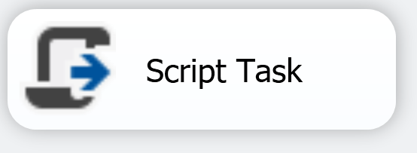
Script Task
Allows to perform functions not available by other control tasks.
Script can be written in C# or VB.Net
Can reference large collection of .Net library
Script can read SSIS variable & parameters
Script can write back to SSIS variables
Also allows you to reuse pre-developed .NET Assemblies
Notes:
https://docs.microsoft.com/en-us/sql/integration-services/control-flow/script-task?view=sql-server-2017

Slide 40
Using Script Task
Lab 5

Slide 41
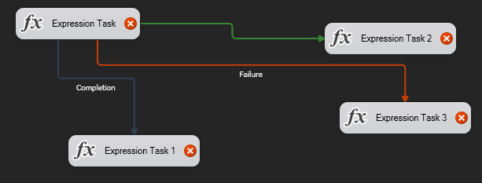

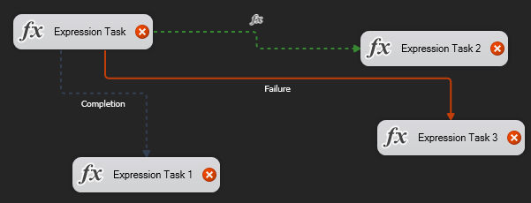
Precedence Constraints
Three Types
Success
Failure
Completion
Can also make it on condition by using expressions.
Can combine and/or logic.

Slide 42
Bringing it Together
Lab 6

Slide 43
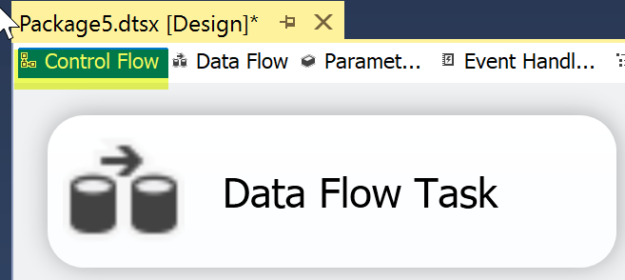
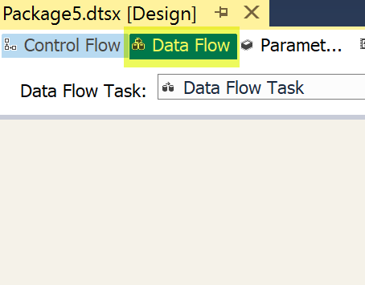
Data Flow Task
Used to
Extract data from Source
Transform (clean/modify) data as it is moved from source to target
Load transformed data to Destination
E.g.: Importing and Exporting data.
Added on Control Flow tab, Designed in Data Flow tab
No required properties but will do nothing by itself.
This task will be covered in later module.
Notes:
https://docs.microsoft.com/en-us/sql/integration-services/control-flow/data-flow-task

Slide 44
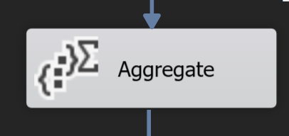
Aggregate Transform
Performs Aggregate functions
Sum, Average, Min, Max, Count, Count Distinct
Group By
KeyScale may be required for large data sets
Required Properties
Column to perform Aggregate
Type of Aggregate Operation to perform
Notes:
https://docs.microsoft.com/en-us/sql/integration-services/data-flow/transformations/aggregate-transformation?view=sql-server-2017

Slide 45
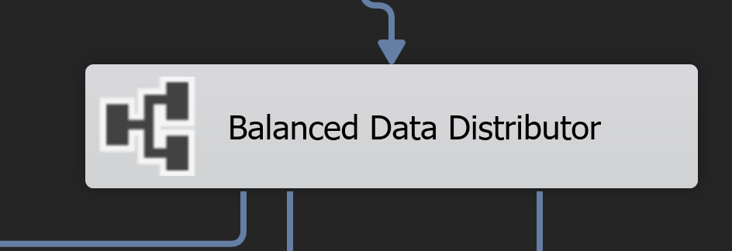
Balance Data Distributor
Distributes buffers of incoming rows uniformly across outputs on separate threads
Distributes data in round-robin fashion
Distribution depends on Data Flow settings
DefaultBufferSize
DefaultBufferMaxRows
Notes:
https://docs.microsoft.com/en-us/sql/integration-services/data-flow/transformations/balanced-data-distributor-transformation?view=sql-server-2017

Slide 46
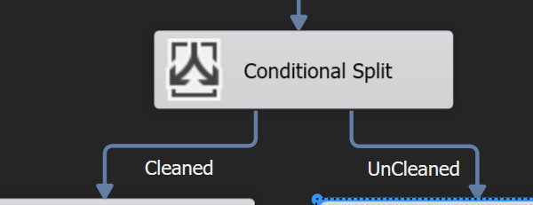
Conditional Split Transform
Split the incoming data into different outputs based on Expression conditions
Required properties
Expressions to split out data streams
Notes:
https://docs.microsoft.com/en-us/sql/integration-services/data-flow/transformations/conditional-split-transformation?view=sql-server-2017

Slide 47
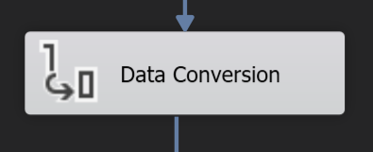
Data Conversion Transform
Converts data from one data type to another.
Required properties
Column to convert the data type to
New Data Type
New Column Name
Similar operation can also be performed by Derived Columns
Notes:
https://docs.microsoft.com/en-us/sql/integration-services/data-flow/transformations/data-conversion-transformation?view=sql-server-2017

Slide 48
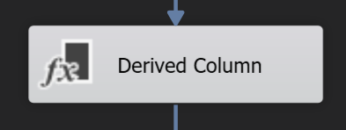
Derived Column Transform
creates new column by applying transformation expressions to input.
Required properties
Column Name – New or Replace
Column Transformation Expression
Can achieve same functionality as Data Conversion
by performing Type Casting Expression transformation you are achieving the same functionality as Derived Columns
Notes:
https://docs.microsoft.com/en-us/sql/integration-services/data-flow/transformations/derived-column-transformation?view=sql-server-2017

Slide 49
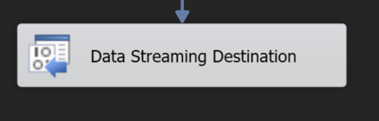
Data Streaming Destination
Exposes data via SSISOLEDB Provider
Allows you to create a linked server to query results from SSIS Package execution
Use the Data Feed Publishing Wizard
Select SSIS Package
Select Database
View Name which will query linked server that returns results from executing SSIS package
Linked Server Name

Slide 50
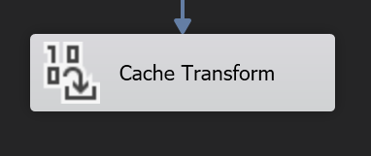
Cache Transform
Writes data to a cache (a .caw file) with Cache Connection Manager.
Reuse cache between multiple Lookup transforms to reduce database load.
Share the case to reduce Memory usage.
cache data stored in clear text not recommended for sensitive data.
Requirements
Cache Connection Manager
Must set Index Position
Notes:
https://docs.microsoft.com/en-us/sql/integration-services/data-flow/transformations/cache-transform?view=sql-server-2017

Slide 51
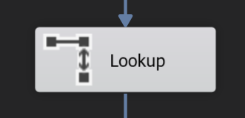
Lookup Transform
Joins additional columns to data flow by looking up values in a table.
Required Properties
OLEDB Connection Manager or Cache Connection Manager
Lookup Table Name
Column Mapping for Joining
Lookup Table’s Column Name to Output
Notes:
https://docs.microsoft.com/en-us/sql/integration-services/data-flow/transformations/lookup-transformation?view=sql-server-2017

Slide 52
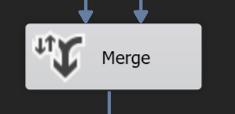
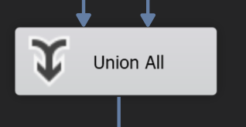
Merge Transform
Combines rows from multiple sorted data flows into one sorted data flow. (ie. Append)
Required Properties
Pre Sorted inputs
Union All Transform
Combines rows from multiple data flows into one data flow. (ie. Append)
Notes:
https://docs.microsoft.com/en-us/sql/integration-services/data-flow/transformations/merge-transformation?view=sql-server-2017
https://docs.microsoft.com/en-us/sql/integration-services/data-flow/transformations/union-all-transformation?view=sql-server-2017

Slide 53
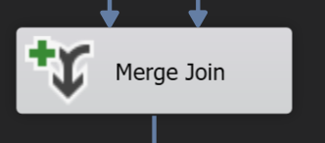
Merge Join Transform
Perform INNER JOIN, LEFT OUTER JOIN, RIGHT OUTER JOIN on sorted data
Required Properties
Select Join Type
Select Columns to Output
Provide Output Column Alias
Notes:
https://docs.microsoft.com/en-us/sql/integration-services/data-flow/transformations/merge-transformation?view=sql-server-2017

Slide 54
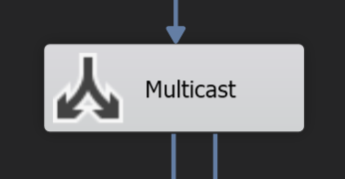
Multicast Transform
create logical copies of input data as outputs
Eg: one output to aggregate and summarize and the other output to retain detailed rows.
Notes:
https://docs.microsoft.com/en-us/sql/integration-services/data-flow/transformations/multicast-transformation?view=sql-server-2017

Slide 55
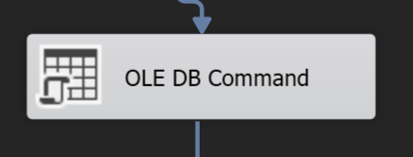
OLEDB Command Transform
Perform a SQL Command for each input row
Required Properties
Connection Manager
SQL Command to execute with Parameter Markers
Column Mapping to Parameters
Can be used to inserts, updates, or deletes rows in a database table
Notes:
https://docs.microsoft.com/en-us/sql/integration-services/data-flow/transformations/ole-db-command-transformation?view=sql-server-2017

Slide 56
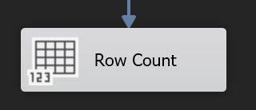
Row Count Transform
Counts rows as they pass through a data flow and stores the final count in a variable
Can be a transform or a destination
Required Properties
VariableName
Notes:
https://docs.microsoft.com/en-us/sql/integration-services/data-flow/transformations/row-count-transformation?view=sql-server-2017

Slide 57
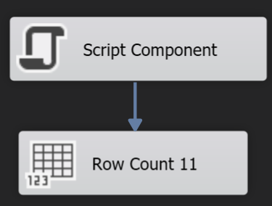
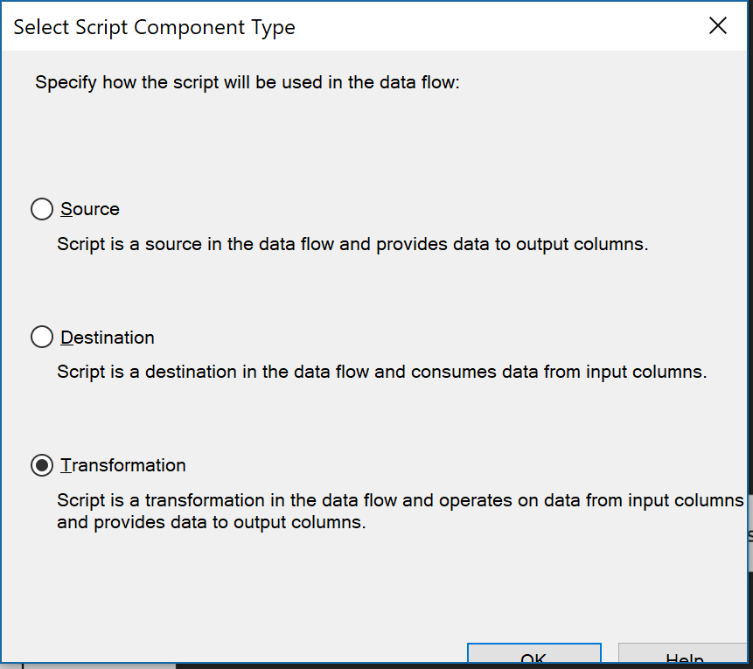
Script Component
Use a script component as one of
Source
Transform
Destination
Notes:
https://docs.microsoft.com/en-us/sql/integration-services/extending-packages-scripting/comparing-the-script-task-and-the-script-component?view=sql-server-2017
https://docs.microsoft.com/en-us/sql/integration-services/extending-packages-scripting-data-flow-script-component-types/creating-a-source-with-the-script-component?view=sql-server-2017
https://docs.microsoft.com/en-us/sql/integration-services/extending-packages-scripting-data-flow-script-component-types/creating-a-destination-with-the-script-component?view=sql-server-2017

Slide 58
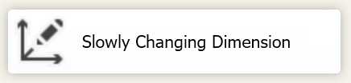
Slowly Changing Dimension Transform
Only supports connections to SQL Server.
Notes:
https://docs.microsoft.com/en-us/sql/integration-services/data-flow/transformations/slowly-changing-dimension-transformation?view=sql-server-2017

Slide 59
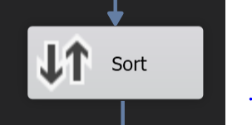
Sort Transform
Sorts input data
Is a blocking transform
All data must be sorted before data can proceed to next transform
Avoid Sort transforms, if possible.
Required Properties
Columns to sort on
Sorting Type (Ascending or Descending)
Sorting Order
Notes:
https://docs.microsoft.com/en-us/sql/integration-services/data-flow/transformations/sort-transformation?view=sql-server-2017

Slide 60
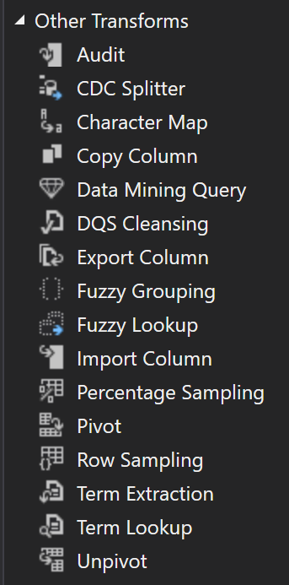
Other Transforms
Special use cases, such as
Change Data Capture
Data Quality Services

Slide 61
Data Flow Mastery
Lab 7

Slide 62
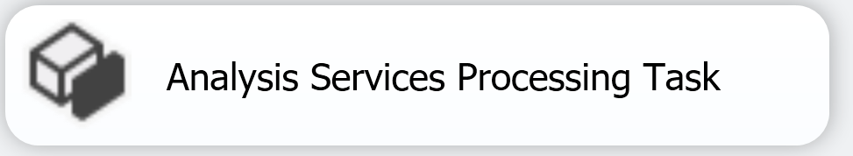
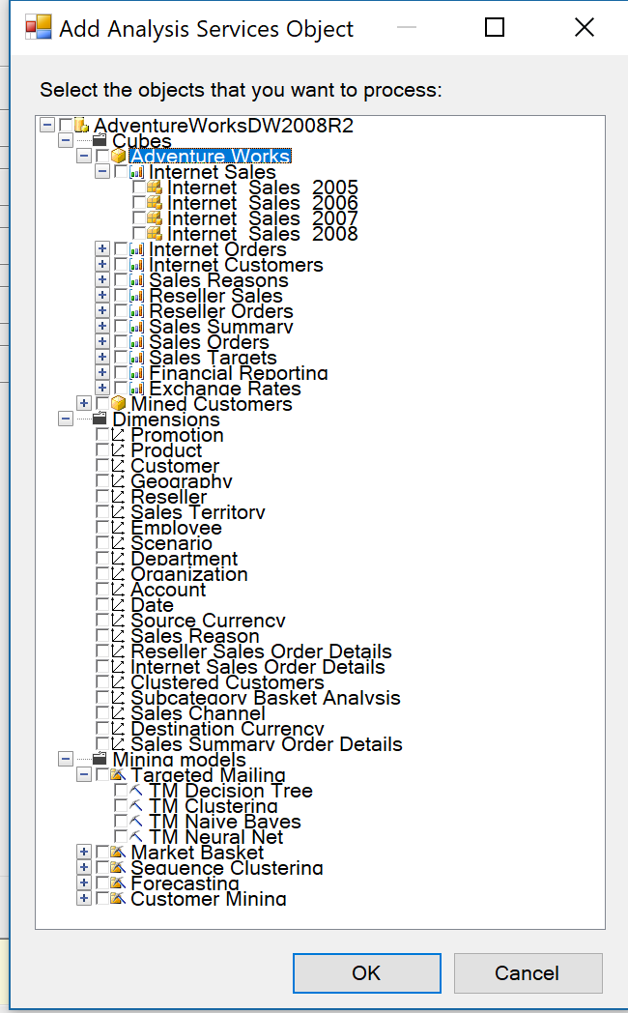
Analysis Services Processing Task
Used to process Multidimensional and Tabular Analysis databases
Required Properties
Connection Manager to use
What to process
Multidimensional - entire db, cube, measure, partition, dimension, mining model
Tabular – Table or Table Partition
Notes:
https://docs.microsoft.com/en-us/sql/integration-services/control-flow/execute-sql-task

Slide 63
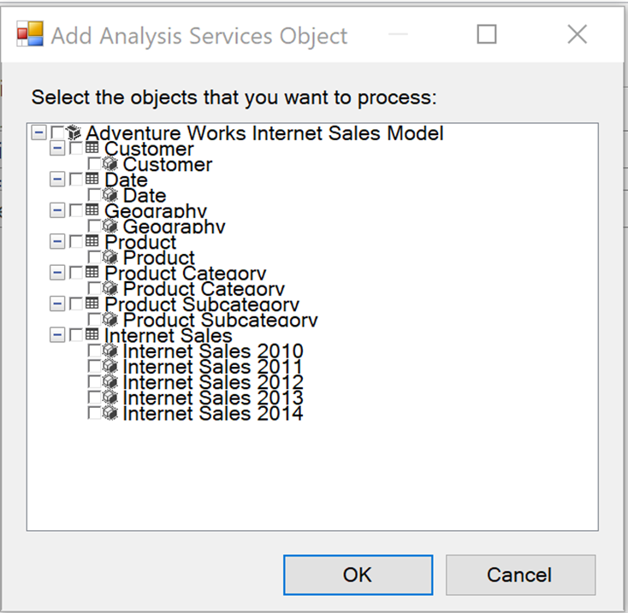
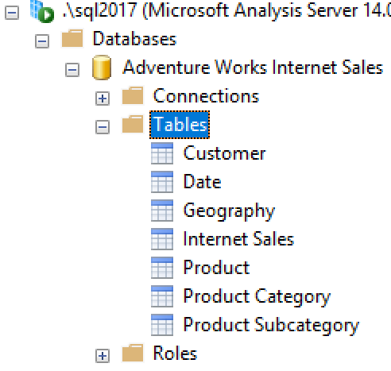
Analysis Services Processing Task Tabular Objects available to process
As seen when selecting Tabular object to process
As seen in SSMS

Slide 64
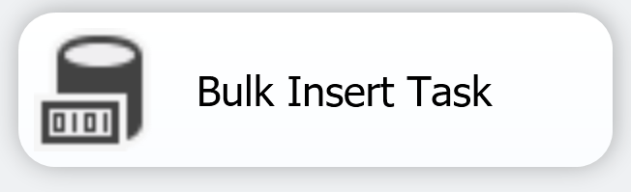
Bulk Insert Task
Used to load data directly from file into SQL Server.
Data can not be transformed while loading data into SQL Server
Required Properties
Source Connection - Data file to load
Format File of the Data
Destination Connection Manager
Destination Table to load the data into.
Notes:
https://docs.microsoft.com/en-us/sql/integration-services/control-flow/bulk-insert-task

Slide 65
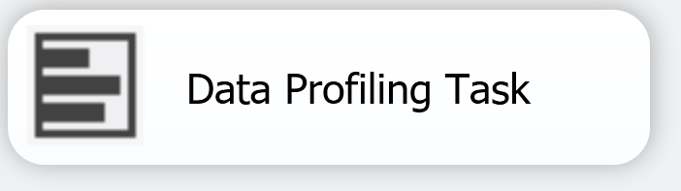
Data Profiling Task
Profiles a data source and identifies data quality problems.
Required Properties
DestinationType – File or Variable
Destination – FileConnection or VariableName
Select Profile Type Request(s)
Connection Manager
Table or View to profile
Column(s) to profile from Table or View
File Destination preferred, to use the Data Profile Viewer
Notes:
https://docs.microsoft.com/en-us/sql/integration-services/control-flow/data-profiling-task
This task does not work with third-party or file-based data sources.

Slide 66
Data Profiling Task (2)
Usage example
discover likely foreign keys in an unfamiliar data set.
confirm set of columns in a table is a key
help identify potential data quality issues
Requirements and Limitations
only works with SQL Server data
This task does not work with third-party or file-based data sources.
read/write permissions & CREATE TABLE permissions, on the tempdb required
Notes:
https://docs.microsoft.com/en-us/sql/integration-services/control-flow/data-profiling-task
This task does not work with third-party or file-based data sources.

Slide 67
Data Profiling Task (3)
Profile Request Type | Notes
Candidate Key Profile Request | Help identify duplicate values in a potential key column
Column Length Distribution Profile Request | Reports all the distinct lengths of string values in the selected column and the percentage of rows in the table that each length represents.
Column Null Ratio Profile Request | Reports percentage of null values in the selected column. Helps to identify when to use Sparse Column based on percentage
Column Statistics Profile Request | Reports statistics, such as minimum, maximum, average, and standard deviation for numeric columns, and minimum and maximum for datetime columns.
Column Value Distribution Profile Request | Reports all the distinct values in the selected column and the percentage of rows in the table that each value represents. Can also report values that represent more than a specified percentage of rows in the table.
Functional Dependency Profile Request | Reports the extent to which the values in one column (the dependent column) depend on the values in another column or set of columns (the determinant column).
Value Inclusion Profile Request | Computes the overlap in the values between two columns or sets of columns. This profile can determine whether a column or set of columns is appropriate to serve as a foreign key between the selected tables
Notes:
https://docs.microsoft.com/en-us/sql/integration-services/control-flow/data-profiling-task
https://docs.microsoft.com/en-us/sql/relational-databases/tables/use-sparse-columns

Slide 68
Data Profiling Task (4)
Profile Request Type | Notes
Column Pattern Profile Request | Reports a set of regular expressions that cover the specified percentage of values in a string column. This profile helps you identify problems in your data, such as string that are not valid. This profile can also suggest regular expressions that can be used in the future to validate new values. For example, a pattern profile of a United States Zip Code column might produce the regular expressions: \d{5}-\d{4}, \d{5}, and \d{9}. If you see other regular expressions, your data likely contains values that are not valid or in an incorrect format
Notes:
https://docs.microsoft.com/en-us/sql/integration-services/control-flow/data-profiling-task
https://docs.microsoft.com/en-us/sql/relational-databases/tables/use-sparse-columns

Slide 69
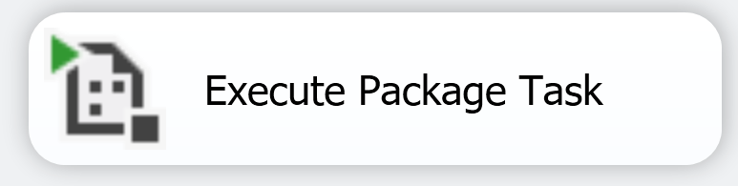
Execute Package Task
Runs another package as part of current package’s control flow.
Required Properties
PackageNameFromProjectReference – Child package to exeucte
Used for
Breaking down complex package workflow
Reusing parts of packages
Modular Package development, for multiple developers
Also supports passing Parameters from Parent Package to Child Package
Notes:
https://docs.microsoft.com/en-us/sql/integration-services/control-flow/execute-package-task

Slide 70
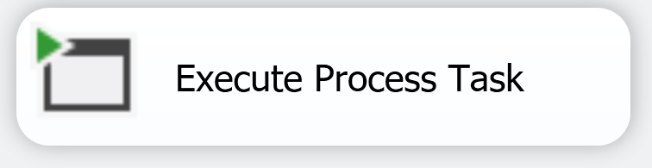
Execute Process Task
runs an application or batch file
Required Properties
Executable to run
Used for
Calling external utilities
Reusing existing batch files, PowerShell scripts
Peforming functionality unavailable in existing Control Flow Task
Eg: Secure FTP Transfer, File Compression/Uncompression
Can also supply command line arguments
Notes:
https://docs.microsoft.com/en-us/sql/integration-services/control-flow/execute-process-task

Slide 71

File System Task
Perform File and Directory operations in the file system.
Required Properties
One or more File Connection Manager depending on operation
Used to
Create/Copy/Delete/Move Directory
Copy/Delete/Move/Rename File
Set Attributes
Delete Directory contents
Option to overwrite file available.
Will Error, if file exists and attempt to create/move file.
Notes:
https://docs.microsoft.com/en-us/sql/integration-services/control-flow/expression-task

Slide 72
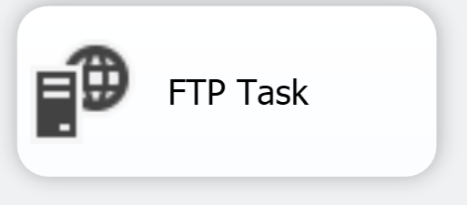
FTP Task
Send email notifications
Supports
File Attachments
Priority – Low, Normal, High
Required Properties
FTP Connection Manager
Rest varies depend on action
For files transfer require remote path and Local File connection manager
Used to
Download files from FTP server
Upload files to FTP Server
Create/remove folder on FTP Server
Create/remove folder on local Server
Can not connect to Secure FTP (SFTP).
Notes:
https://docs.microsoft.com/en-us/sql/integration-services/control-flow/ftp-task

Slide 73

Hadoop Hive Task
Run Hive script on a Hadoop cluster
Required Properties
Hadoop Connection Manager
InlineScript – Hive job script to execute
Notes:
https://docs.microsoft.com/en-us/sql/integration-services/control-flow/hadoop-hive-task?view=sql-server-2017

Slide 74
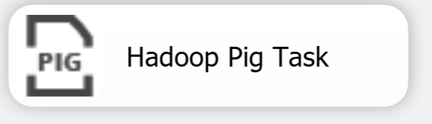
Hadoop Pig Task
Run Pig script on a Hadoop cluster
Required Properties
Hadoop Connection Manager
InlineScript – Pig job script to execute
Notes:
https://docs.microsoft.com/en-us/sql/integration-services/control-flow/hadoop-pig-task?view=sql-server-2017

Slide 75
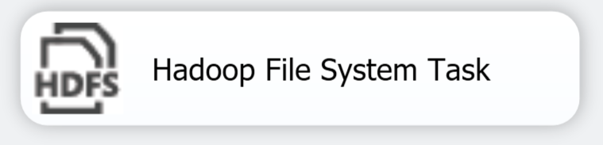
Hadoop File System Task
Copy files from, to, or within a Hadoop cluster
Required Properties
Hadoop Connection Manager
File Connection Manager ( if copying from or to Hadoop)
Notes:
https://docs.microsoft.com/en-us/sql/integration-services/control-flow/hadoop-file-system-task?view=sql-server-2017

Slide 76

Send Mail Task
Send Email Notifications.
Required Properties
SMTP Connection Manager
From email address
To email address
Subject
Also supports
File attachments
Message Priority – Low, Normal, High
Notes:
https://docs.microsoft.com/en-us/sql/integration-services/control-flow/send-mail-task

Slide 77
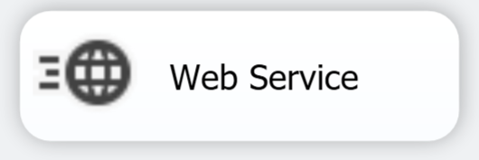
Web Service Task
Execute a web service and store return value in file or variable.
Required Properties
HTTP Connection Manager
WSDL file – download location for Web Services Description Language (WSDL)
Input – Web Service, Method, and input parameters
Output – File or variable to store returned value
Allows developer to easily use vendors webservices
Notes:
https://docs.microsoft.com/en-us/sql/integration-services/control-flow/web-service-task
Sample Webservice links takes longitude and latitude to find nearest airports
https://m.jetairways.com/jetmw/webservice.asmx?wsdl
https://m.jetairways.com/jetmw/webservice.asmx?op=GetNearestAirports
You can use following to find longatitutes and latitutdes using Map
http://www.mapcoordinates.net/en

Slide 78
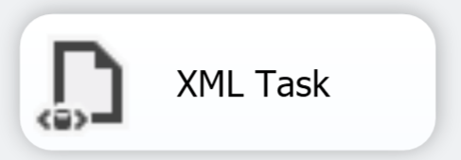
XML Task
work with xml data.
Required Properties
File Connection Manager(s)
Rest varies depend on XML Operation
Used to
Transform XML using Extensible Stylesheet Language Transformations (XSLT)
Performs XPath queries and evaluations
Validate XML
Compare and Merge multiple xml documents
Notes:
https://docs.microsoft.com/en-us/sql/integration-services/control-flow/xml-task

Slide 79
XML Task (2)
XML Operation Type | Notes
Diff | Compare two XML documents, and write difference to XML Diffgram document.
Patch | Applies the output from the Diff operation, called a Diffgram document, to an XML document, to create a new parent document that includes content from the Diffgram document.
Validate | Validate XML document against Document Type Definition (DTD) or XML Schema definition (XSD) schema.
XPath | Performs XPath queries and evaluations.
XSLT | Transform XML documents using XSLT (Extensible Stylesheet Language Transformations)
Notes:
https://docs.microsoft.com/en-us/sql/integration-services/control-flow/xml-task

Slide 80
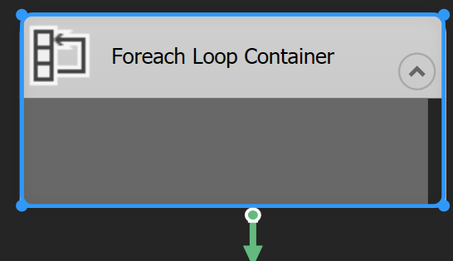
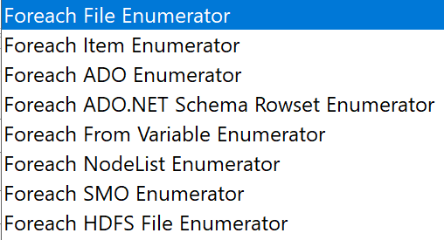
For Each Loop Container
Loop through specified enumerator.
Similar to For Loop container.
Required Properties
Enumerators
Additional properties specific to enumerator
Available enumerators are
Notes:
https://docs.microsoft.com/en-us/sql/integration-services/control-flow/foreach-loop-container?view=sql-server-2017

Slide 81
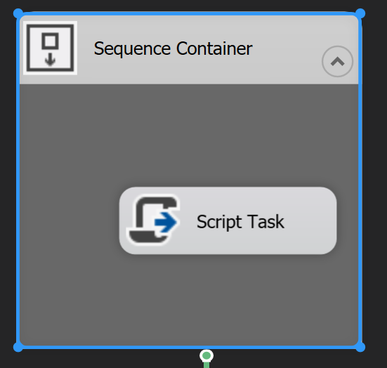
Sequence Container
Group tasks into a container.
Can be enabled/disabled
Can participate in a transaction
Only for grouping control flow tasks/containers
Notes:
https://docs.microsoft.com/en-us/sql/integration-services/control-flow/sequence-container

Slide 82

Grouping/Ungrouping components
Group tasks within both Control flow and Data Flow
Can not be enabled/disabled
Can not participate in a transaction
Notes:
https://docs.microsoft.com/en-us/sql/integration-services/group-or-ungroup-components?view=sql-server-2017

